Slide 1
ABOUT THIS TEMPLATE
We have assembled this template for your benefit, to make preparation as simple as possible with predefined fonts & colors and different options for content and transition slides.
You can stick with simple text-based slides or get fancier with text + graphics. It’s up to you!
You do not need to use all of the slides from the template. Each slide is there to save you from having to build your own slide layouts.
It also ensures your presentation will have a common look and feel to others being presented at User Group Focus.
Please delete this slide before submitting your deck to the portal.
Thank you for your contribution to User Group Focus and have fun!

Slide 2
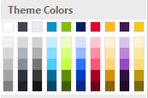
Slide palette info
The PowerPoint palette for this template has been built for you and is shown below. Avoid using too many colors in your presentation.
Use Accent 1 as the main accent color.
Use Accent 2 and Accent 3 when additional colors are needed.
Accent colors 1–6
TEXT
DARK
ACCENT 1
ACCENT 2
ACCENT 3
ACCENT 4
ACCENT 5
ACCENT 6
ACCENT 7

Slide 3
Icons (light)

Slide 4
Icons (light)

Slide 5

Icons (dark)

Slide 6
Icons (dark)

Slide 7
Notes (hidden)
Some speakers like to use this slide for hidden “notes slides”.
Delete it if you don’t want to use it.
NEXT: <next slide title>

Slide 8
Session Objectives
What will you learn today?
Learning objective number 1 (required)
Learning objective number 2 (optional)
Learning objective number 3 (optional)

Slide 9
Key Take-aways
This slide is for you to list for you audience:
Key learnings from your session (tied back to the session description and key objectives)
Key actions they should take when back in their office

Slide 10
Suggested Resources
This slide is for you to list for you audience:
Other related sessions at Summit
Helpful websites and blogs
Reference materials

Slide 12
EXTENDING FLOW
USING CUSTOM CONNECTORS

Slide 13
EXTENDING FLOW
USING CUSTOM CONNECTORS

Slide 14


Speakers Example
ABE SALDANA
Power Platform Practice Director
PowerObjects
JASON LATTIMER
Development Manager & Business Applications MVP
PowerObjects

Slide 15










PowerObjects History of who we are
SERVICE
SUPPORT
EDUCATION
ADD-ONS
No. 1 Microsoft Business Applications Service Provider globally
1,175 Active Microsoft Dynamics 365 Customers
PowerObjects was founded in 1993
1,000,000 Global PowerObjects PowerPack Users
100% focused on CRM since 2008 | HCL Acquisition in 2016 Inherited the ERP practice along with the new Dynamics 365 product offering. Now focused on Microsoft Business Applications.
One of the most visited Dynamics websites in the world- including our blog and our free online Dynamics guidebook
Worldwide Microsoft Partner of the Year in several categories in 2012 - 2017
450 Onshore, 1,000 global staff with 5 global offices

Slide 16
Session Agenda
Overview
Introduction to Custom Connectors
Creating a Simple Custom Connector
Creating a Complex Custom Connector

Slide 17
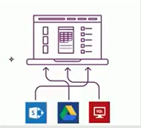
Connectors
A connector is a wrapper around and “API” that allows the underlying service to talk to Microsoft Flow and PowerApps

Slide 18
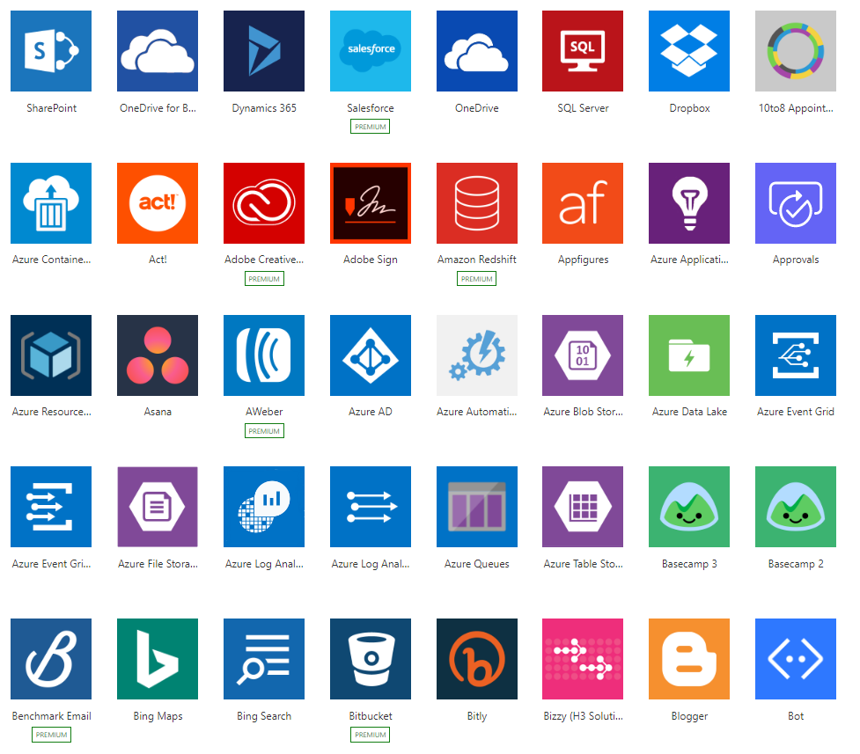
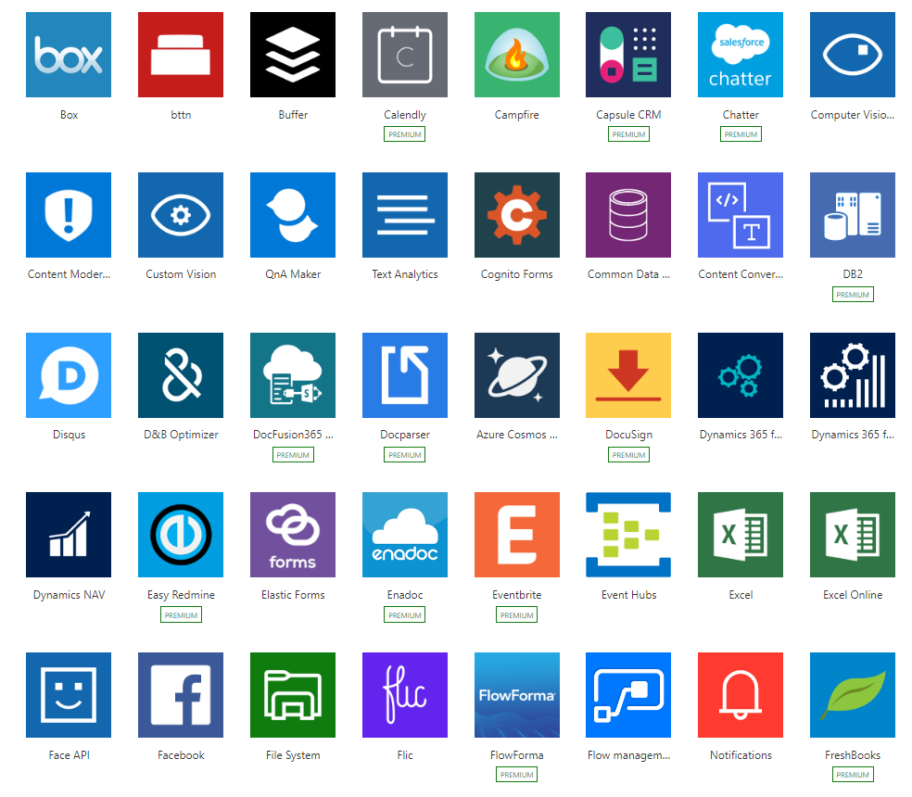
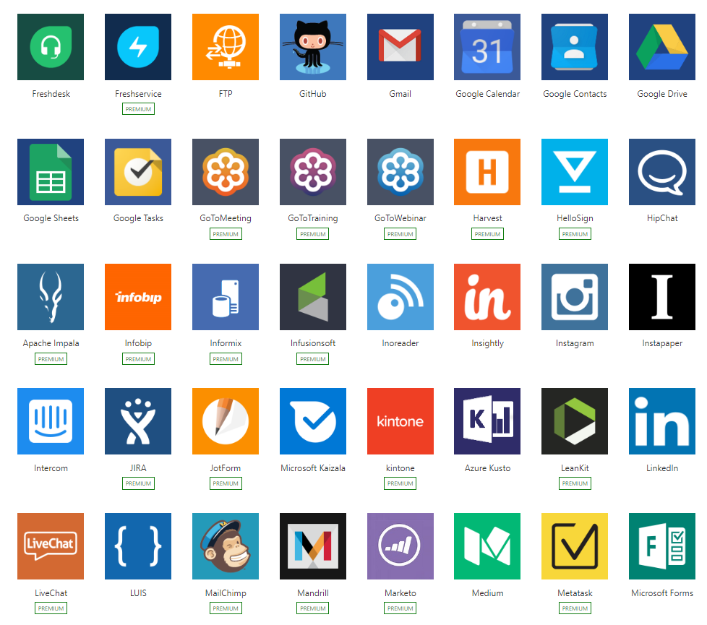
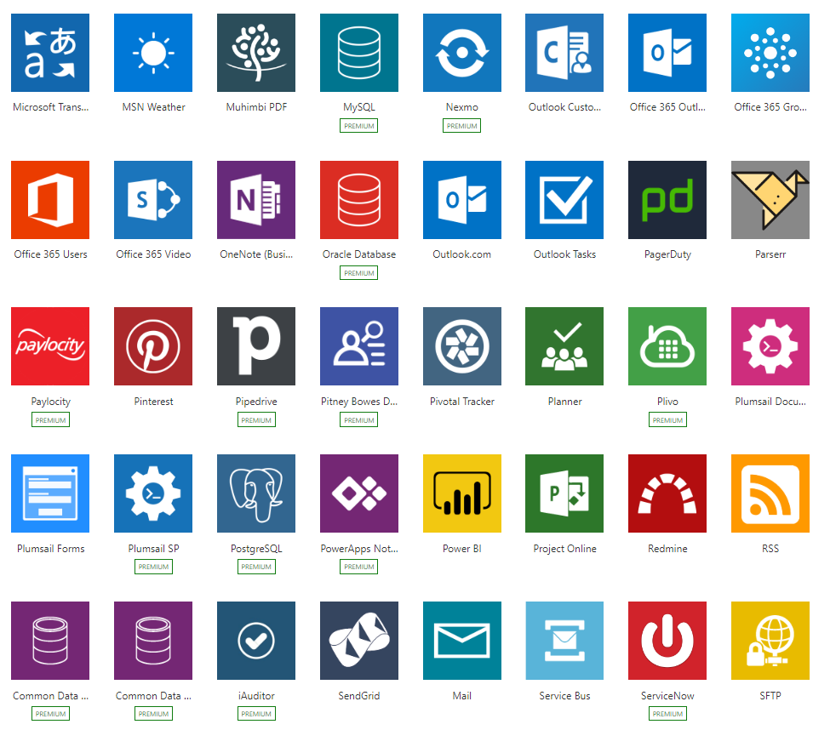
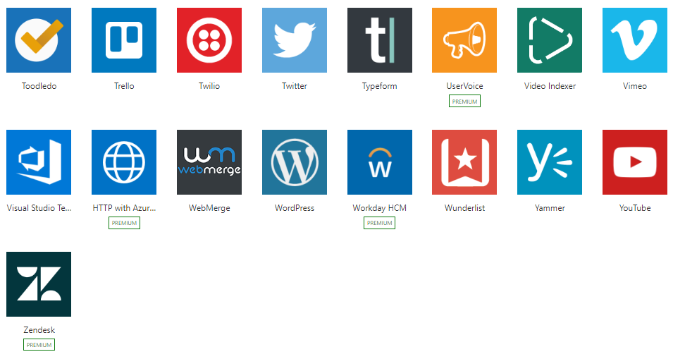
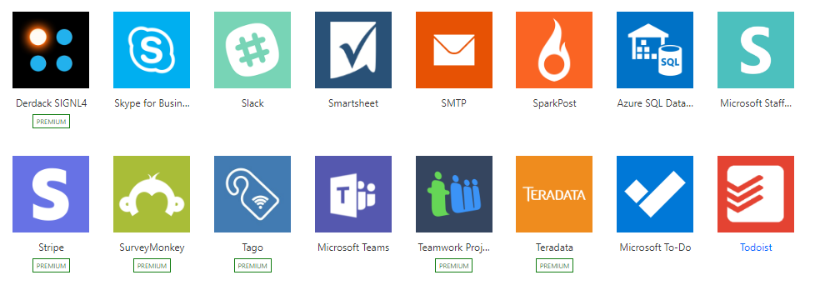
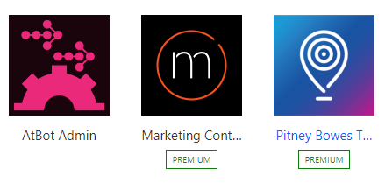
Integration + Connectivity
Built-in connectivity to 200+ SaaS cloud services, file providers, databases, web APIs, productivity apps, and more
Connect to on-premises systems via Data Gateway
Pluggable extensibility via Custom Connectors to integrate existing LOB systems into Flow

Slide 19
Why build a connector?
Enterprise developers
Looking for connectivity to a service we don’t currently support. Need connectivity to a custom or internal service.
Partners and ISVs
Expand the number of services you integrate with. Provide the extensibility your customers need. Increase exposure and adoption.

Slide 20
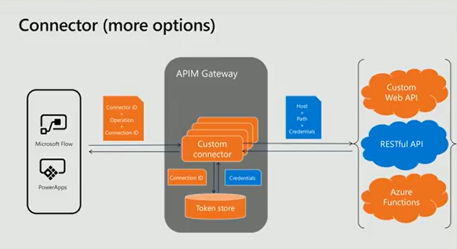

Slide 21
Developing a Custom Connector
Understand the API for the Service
Start from scratch, an OpenAPI definition or a Postman collection
Setup the authentication used by the API
Anonymous
Basic (User + Password)
API Key
OAUTH 2.0 (Cloud only) – including AAD
Windows (On-premises only)
Define the operations for your connector
Improve the request and response from a sample payload
Save and Test your connector in Flow or/and PowerApps

Slide 22
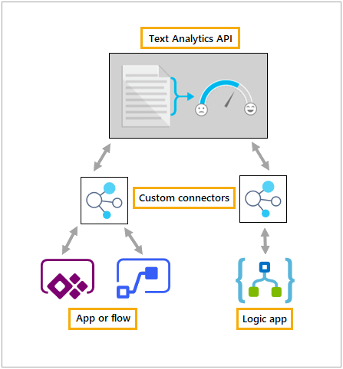
Building a Custom Connector
Develop
Test
Share
Build, secure and describe your API.
Import from existing artifacts (Open API, Postman) or build from scratch
Validate your API calls
Use in Flow and PowerApps for E2E testing.
Allow other users within your organization to use your connector.
https://docs.microsoft.com/en-us/connectors/custom-connectors/

Slide 23
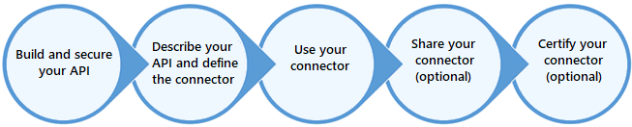
Build a Custom Connector for ISV’s

Slide 24
Create a new Custom Connector Demo
Create a new custom connector for YELP API
Get restaurants in the area
Abe Final
https://docs.microsoft.com/en-us/connectors/custom-connectors/define-blank

Slide 25
Complex Connectors
Jason
Presents

Slide 26
Custom Connector Considerations
Security / authorization
Supports: Generic OAuth, OAuth for specific services like AAD, Basic, & API key
API
Hosting costs (private)
Limiting access (private)
Consumption costs (public)
Performance (public & private)
Platform limitations
500 requests / minute per connector
Logic App: 1,000 connectors
PowerApps or Flow (free): 1 connector & no sharing
PowerApps or Flow (Plan 1 or 2): unlimited connectors

Slide 27
Getting Started
REST API (Logic Apps can use SOAP)
OpenAPI definition (file or URL) or
Postman collection or
Knowledge of the API functionality
Helpful to have knowledge of:
HTTP requests & responses (GET, POST, DELETE, etc.)
JSON data

Slide 28
Open API Specifications
Describes an API
Endpoints
Operations (GET /users, POST /users, etc.)
Input & output parameters
Authentication methods
Contact into, license, terms of use, etc.
Also known an ‘Swagger’

Slide 29
Open API Specifications
Microsoft Extensions
summary
x-ms-summary
description
x-ms-visibility
x-ms-dynamic-values
x-ms-dynamic-schema
https://docs.microsoft.com/en-us/connectors/custom-connectors/openapi-extensions

Slide 30
Good Open API Definitions
Accept & return classes with descriptive property names
Straightforward (but not long) operation names
Visibility (operations & parameters)
Important - always shown to the user first.
Advanced - hidden under an additional menu
Internal - hidden from the user
Requirement level & correct data types prevent errors
Static & dynamic lists – limit to predefined values

Slide 31
Tips
Use parameters marked as Internal with predefined values
Static parameters required by the API that shouldn’t be changed
API keys
Can parameterize values after the base URL
https://www.myapi.com/api/product/{productid}
Return a friendly error message

Slide 32
Gotchas
Cannot parameterize base URLs
https://{subdomain}.myapi.com/products
Creating new connections sometimes just won’t work for 30 minutes
Possible slow responses from Functions on Consumption plans
Modification often requires recreating or reimporting

Slide 33
Create a new Custom Connector Demo
Create a new custom connector to connect to the Open Movie Database (OMDb)

Slide 34
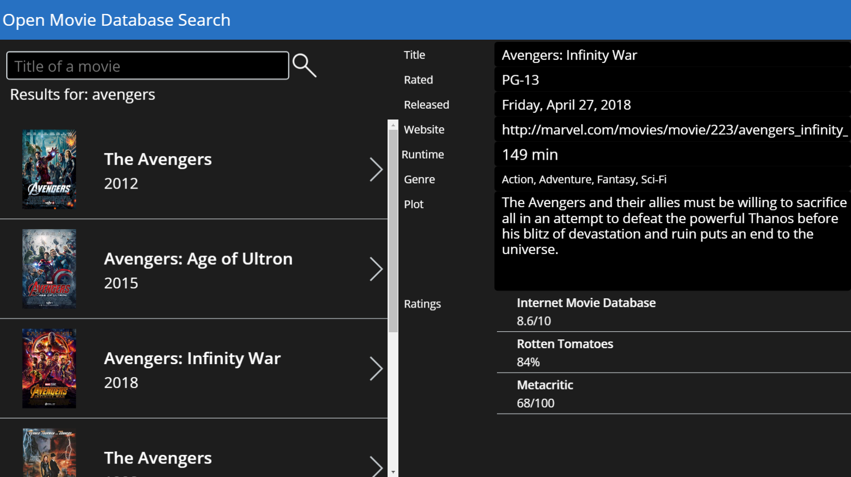
Open Movie Database Search
www.omdbapi.com
Register for API Key
GET based

Slide 35
Create a new Custom Connector Demo
Create a new custom connector to execute a D365 CE custom action

Slide 36
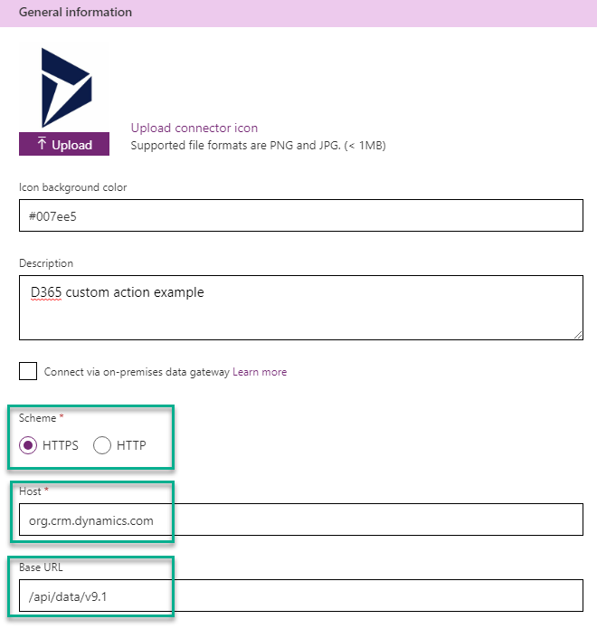
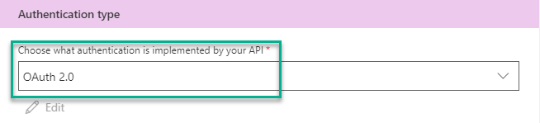
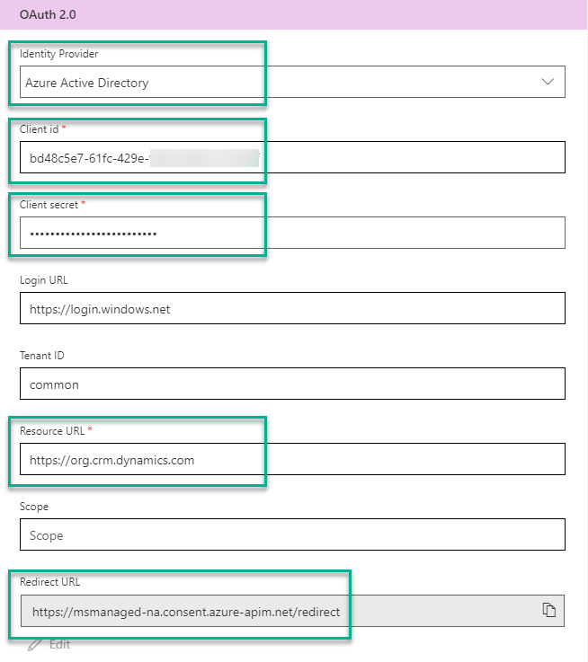
Custom Connector - General & Security

Slide 37
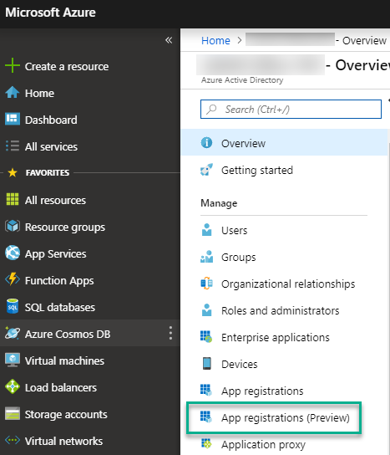
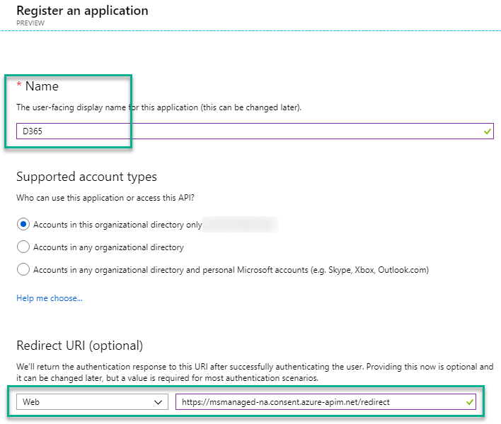
Azure Active Directory

Slide 38
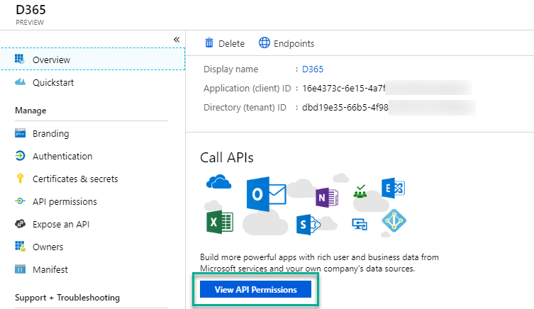
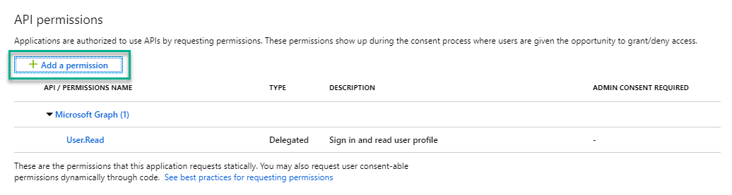
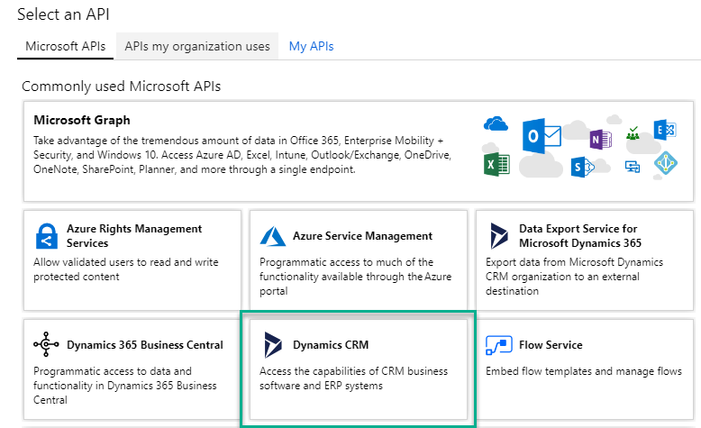
Azure Active Directory

Slide 39
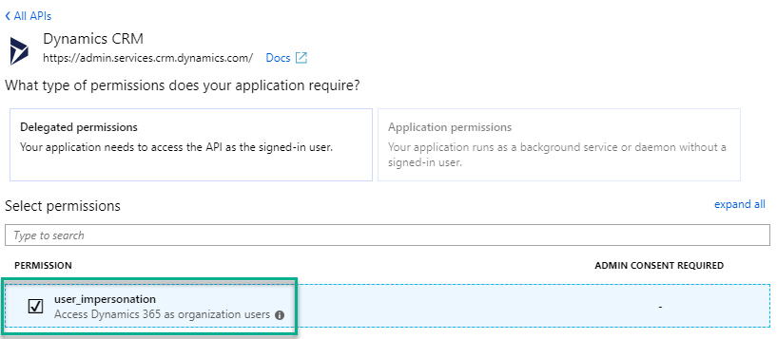
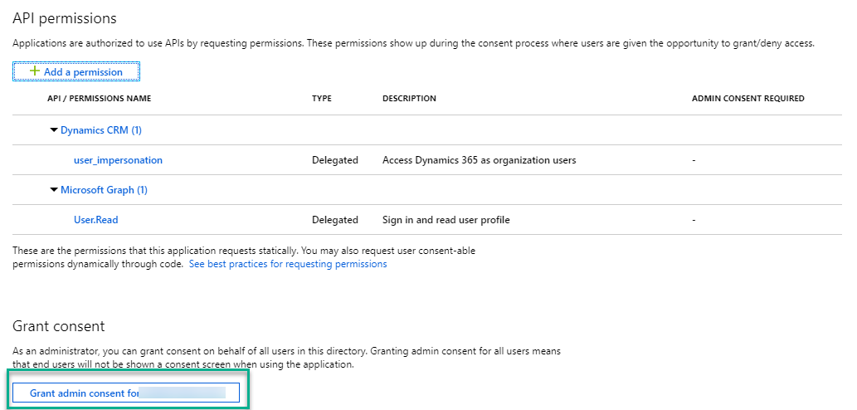
Azure Active Directory

Slide 40
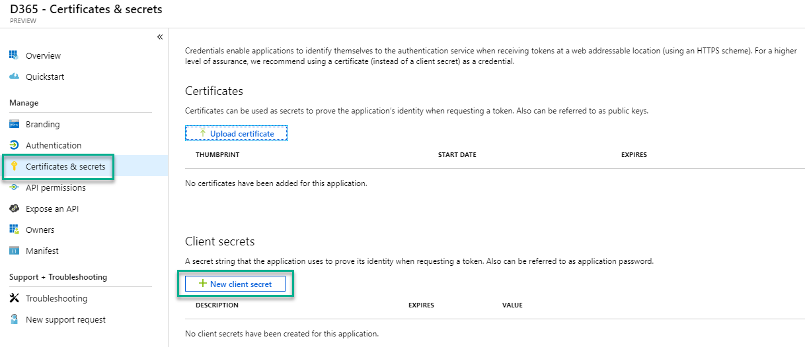
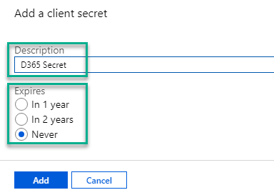
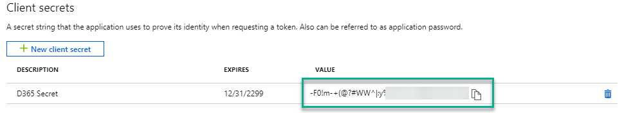
Azure Active Directory

Slide 41
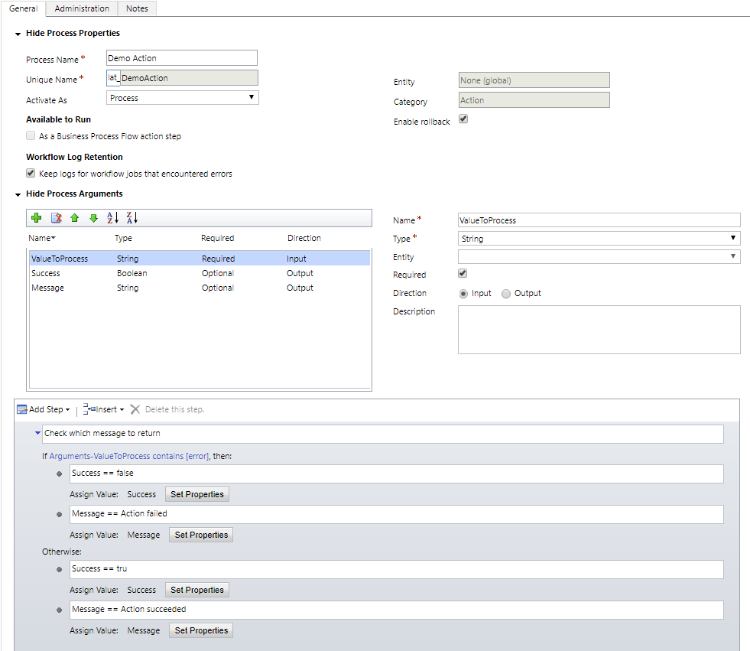
D365 CE Action

Slide 42
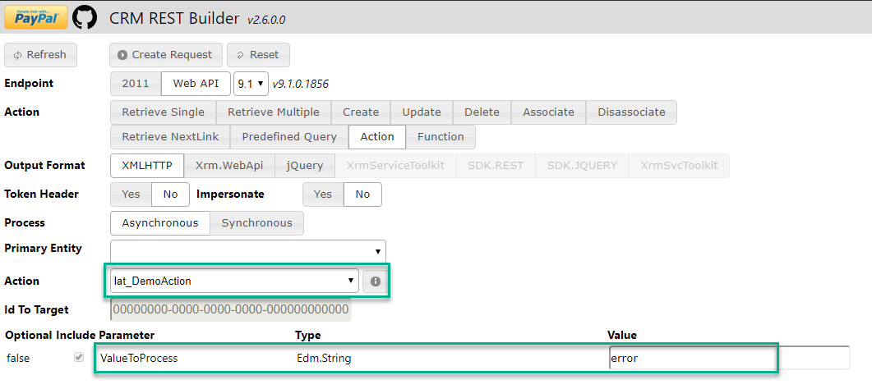
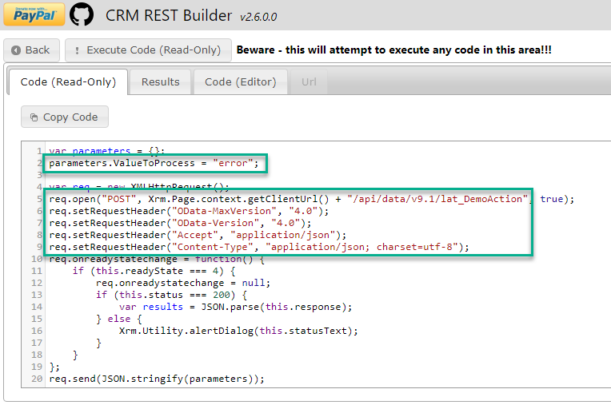
D365 CE Action

Slide 43
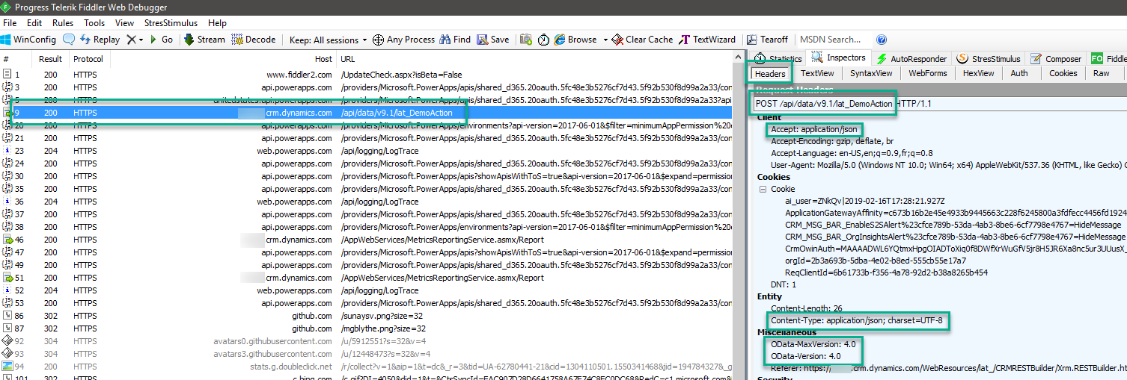
D365 CE Action

Slide 44
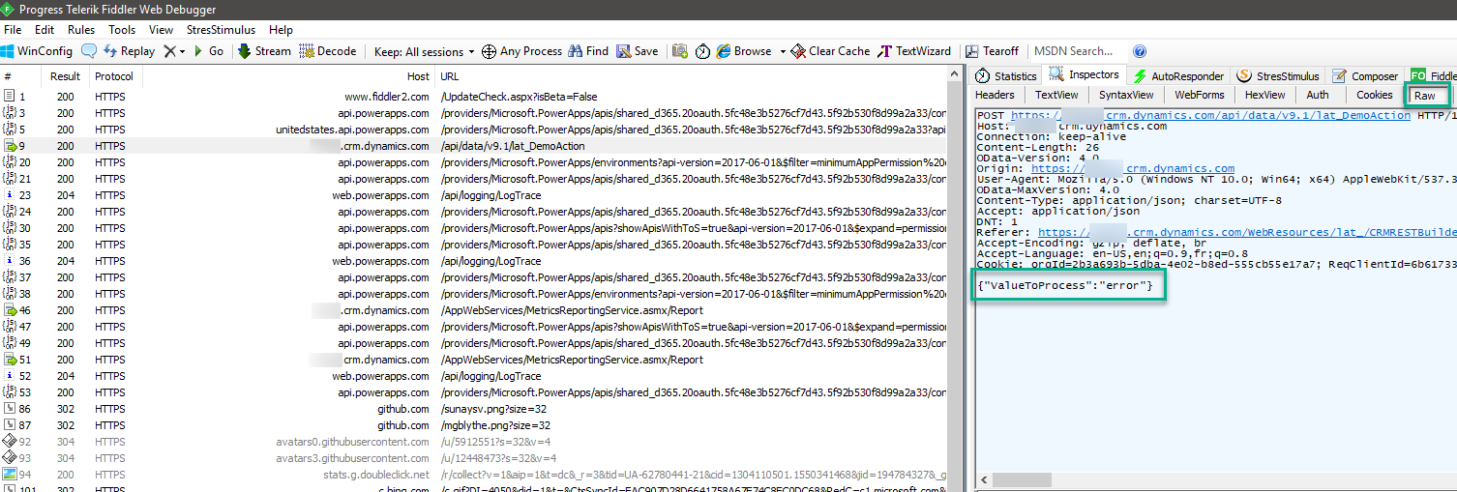
D365 CE Action

Slide 45
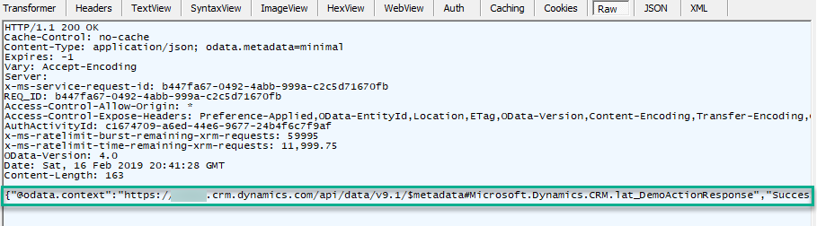
D365 CE Action

Slide 46
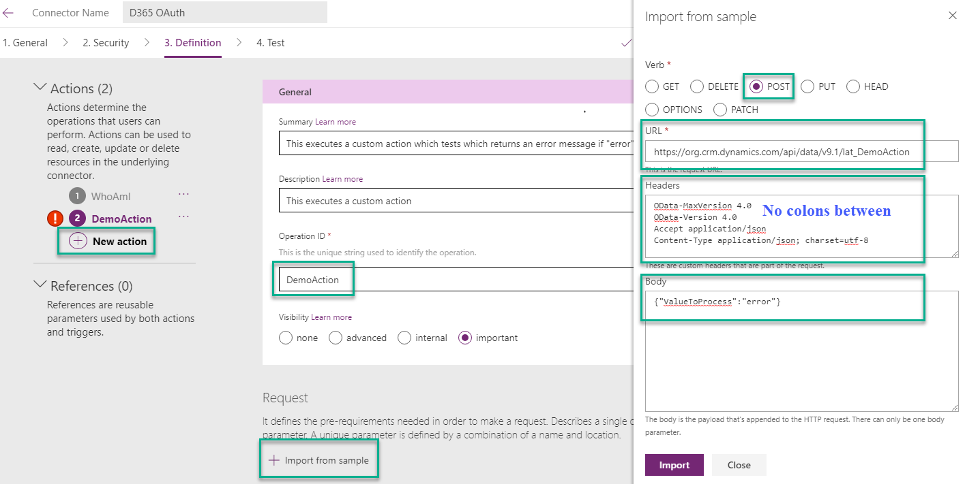
Custom Connector - Definitions

Slide 47
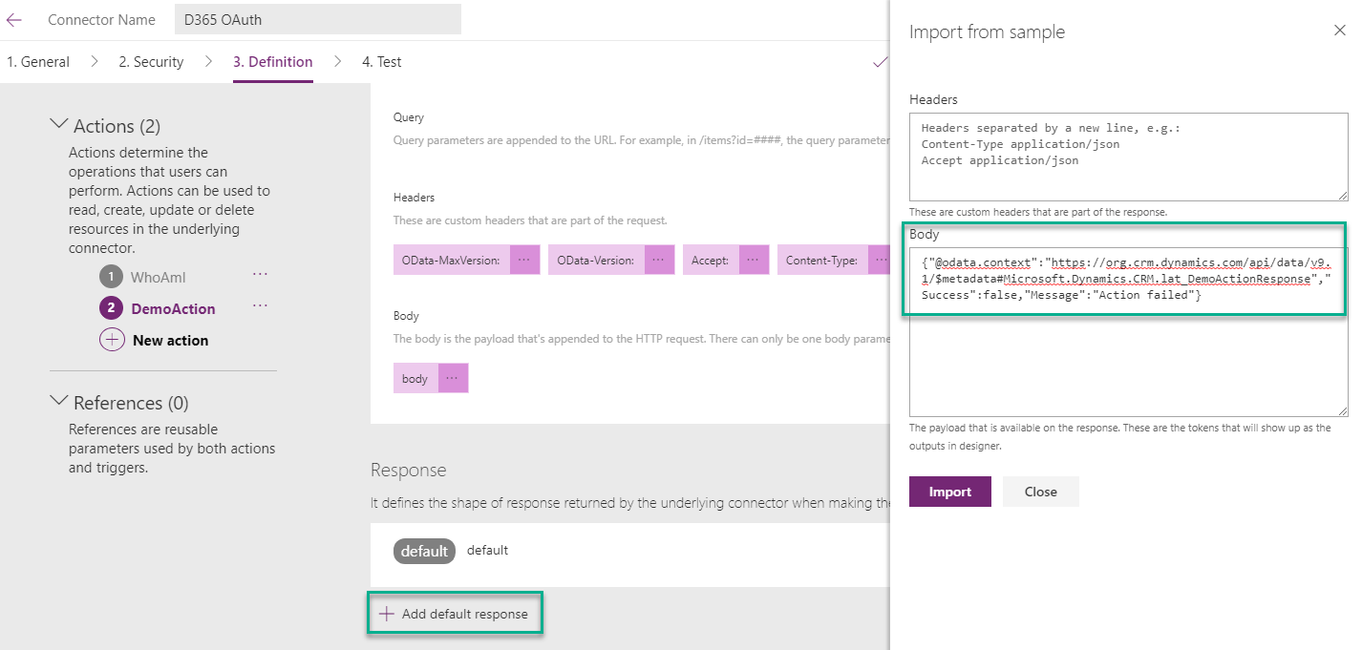
Custom Connector - Definitions

Slide 48
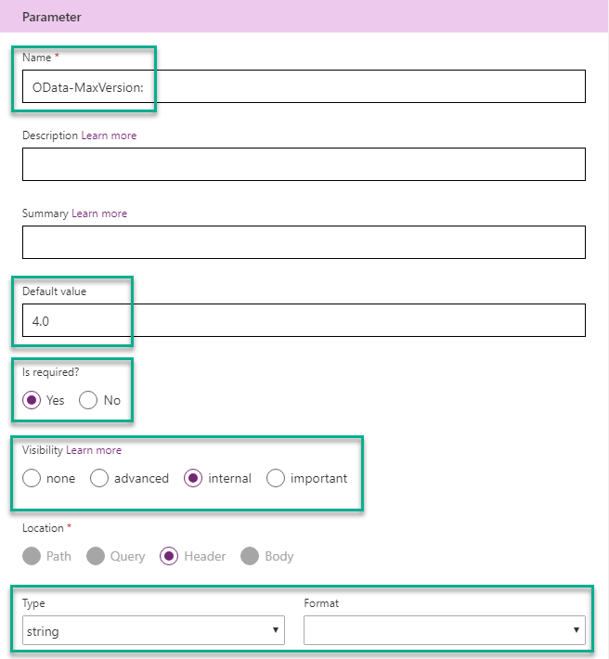
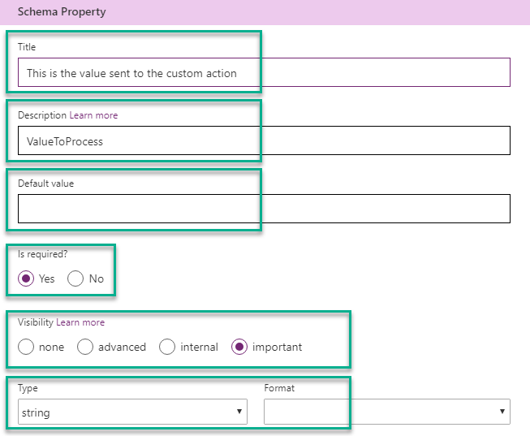
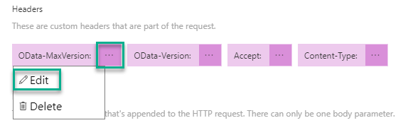
Custom Connector - Definitions

Slide 49
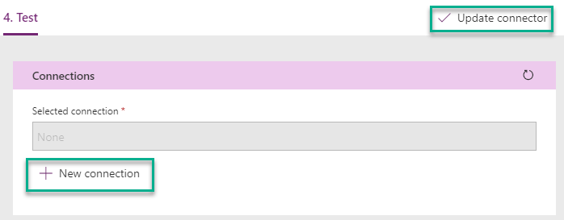
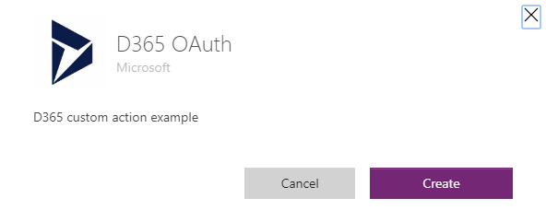
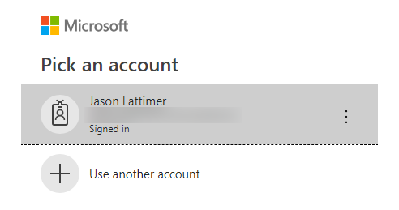
Custom Connector - Test

Slide 50
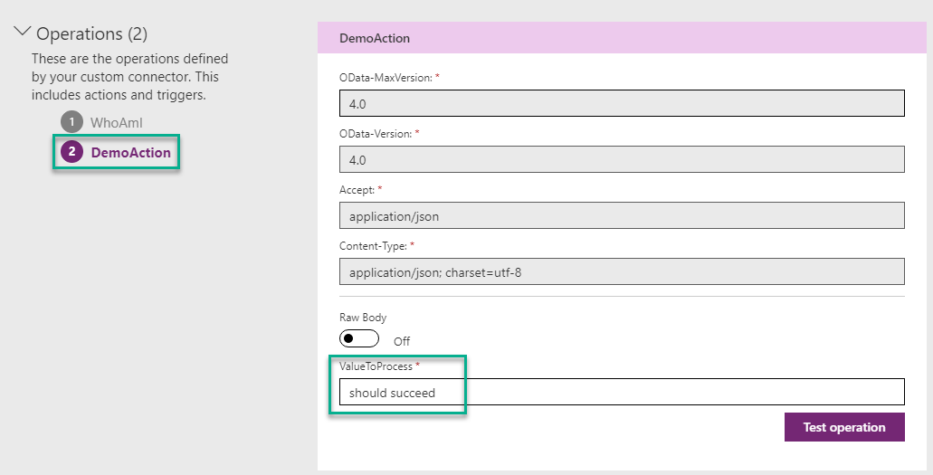
Custom Connector - Test

Slide 51
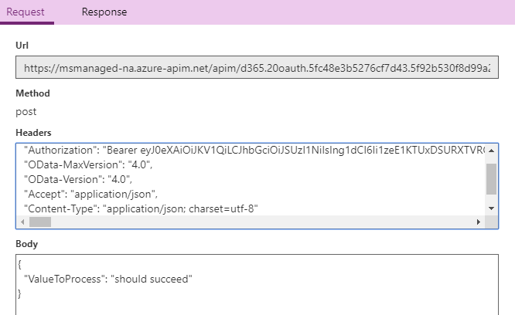
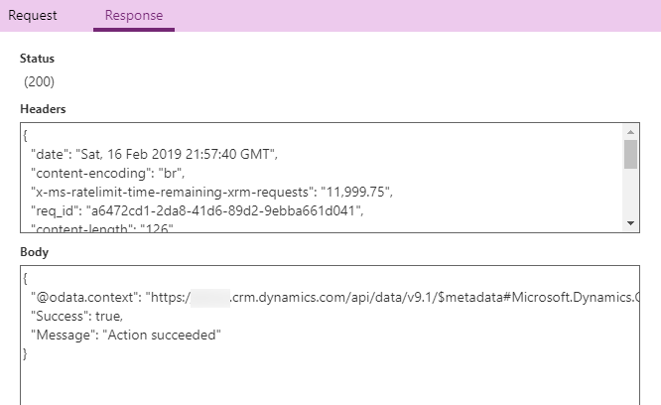
Custom Connector - Test

Slide 52
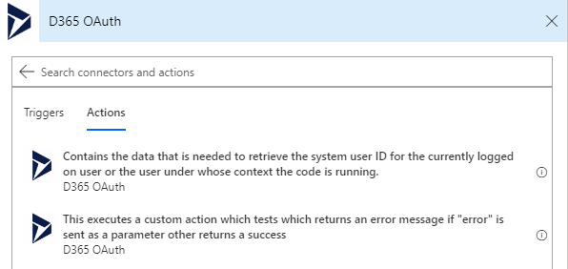
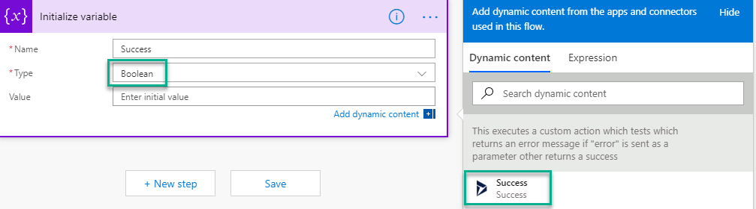
PowerApps & Flow

Slide 53
End Jason

Slide 54

Q & A
This is your last chance to ask questions!

Slide 55
Thank you
Abe Saldana
PowerObjects, Abe.Saldana@hcl-powerobjects.com
Jason W Lattimer
PowerObjects, jason.lattimer@hcl-powerobjects.com
Please complete your surveys now
www.ugfocus.com/houston-survey

Slide 57
Section title

Slide 58
Section title

Slide 59
SECTION TITLE
Main topic 1: size 40pt
Size 20pt for the subtopics
Size 20pt for the subtopics

Slide 60
Text layout (no bullets)
Main topic 1: size 36pt
Size 20pt for the subtopics
Size 20pt for the subtopics
Main topic 2: size 36pt
Size 20pt for the subtopics
Size 20pt for the subtopics

Slide 61
Bullet Points Layout with Subtitle
Subheadline option goes here.
Example of a bulleted slide with a subhead
Set the slide title to “Sentence case”
Set subheads to “Sentence case”

Slide 62
Bullet Points Layout with Subtitle
Subheadline option goes here.
Example of a bulleted slide with a subhead
Set the slide title to “Sentence case”
Set subheads to “Sentence case”
Hyperlink style
www.website.com

Slide 63
Example headline with photo.
Example text point.

Slide 64

Software code slide
This slide layout uses Consolas, a monotype font which is ideal for showing software code.

Slide 65
Lots of data? Minimalize and plan
When a chart or graphic, has more elements than can easily be aligned to the grid, align the outer edges of the group, top, bottom, left and right edges to the grid.
It is preferable to keep the group aligned to the left border.
Gray is used to de-emphasize data that is less important. Use cool gray 3 or cool gray 7. See slide 7 for color formulas.
All elements have the same interior margins as text blocks.
130M
140M
125M
OTHER
OTHER
OTHER
OTHER
OTHER
OTHER

Slide 66
Chart example

Slide 67
Pie chart 2

